Slide 1
CAPTIVATING SOUNDTRACKS

Slide 2
TECHNOLOGY
SHOWCASE
CAPTIVATING SOUNDTRACKS

Slide 3
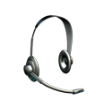
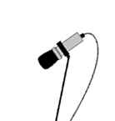
WHAT YOU NEED
A script
A microphone OR a headset with microphone
A laptop or computer
Audio capture software like Audacity
A quiet place! [You can try our Sound Booth in IML]
CAPTIVATING SOUNDTRACKS

Slide 4
WHY HAVE A SCRIPT
You will speak more fluently – especially after practice
Writing the script will focus your thoughts prior to recording and you can practise timing with the same content
Ideally you will by now be happy with your presentation and have it ready to ‘speak to’
CAPTIVATING SOUNDTRACKS

Slide 5
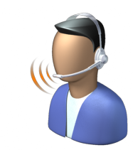
MICROPHONE PLACEMENT
Position the microphone 4 to 10 cms from your mouth, depending upon your microphone type - headset or directional
Do not breathe directly into the microphone
Don't speak down to a fixed microphone - instead, position it above your nose and pointed down at your mouth
Lastly, set the microphone slightly to the side of your mouth, to help soften the sound of the letters S and P.
CAPTIVATING SOUNDTRACKS

Slide 6
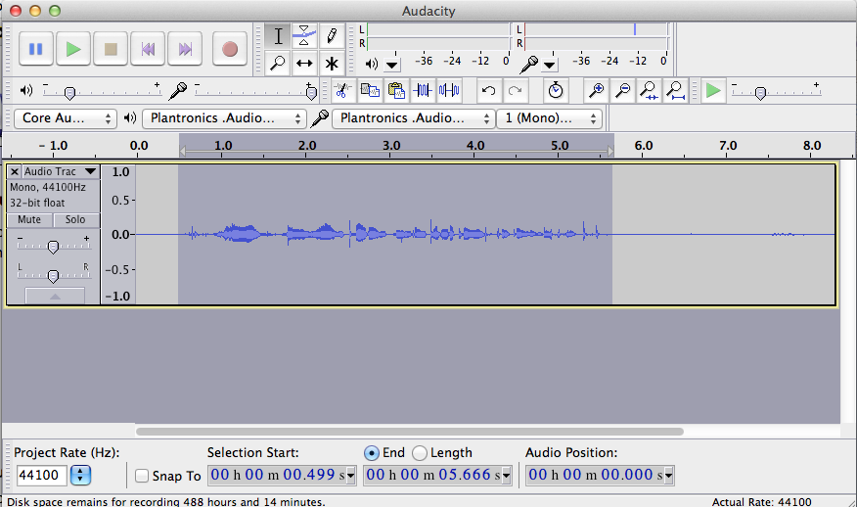
CONSIDER AUDACITY
http://audacity.sourceforge.net/
Open source, easy to use
You can record new projects or edit existing audio files
CAPTIVATING SOUNDTRACKS

Slide 7
READY TO RECORD?
Sit comfortably
If you do make an error, like a mispronunciation or an um or er stop speaking briefly and carry on or repeat a faulty bit. You can edit out small breaks later.
Try recording on one sitting. Just make sure you leave silent breaks between sections or topics. Later, when you edit you can easily capture the required section from the software.
CAPTIVATING SOUNDTRACKS

Slide 8
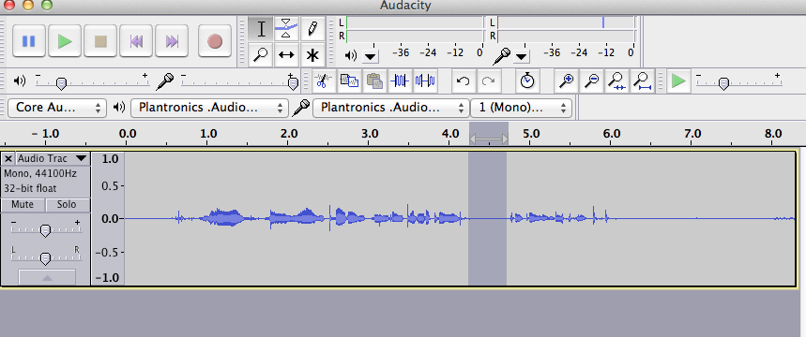
EDITING
Play back your track and listen to the quality
In Audacity you can easily select sections to cut
Once you are happy with a section of track you can select and export it as MP3
CAPTIVATING SOUNDTRACKS

Slide 9
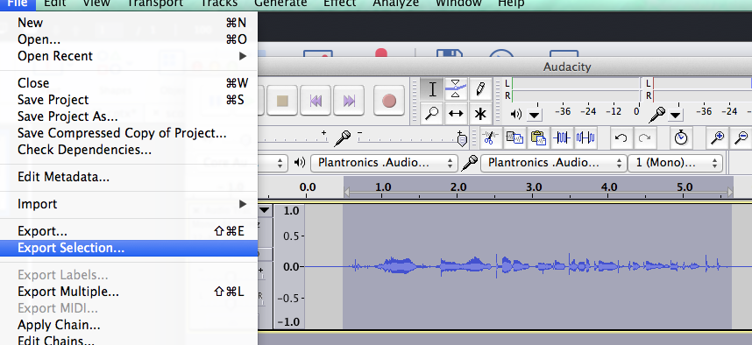
EXPORTING
Select the section to export in Audacity
Choose Export Selection from the file menu and save as MP3 e.g slide01.mp3
CAPTIVATING SOUNDTRACKS

Slide 10
EXPORTING
CAPTIVATING SOUNDTRACKS

Slide 11
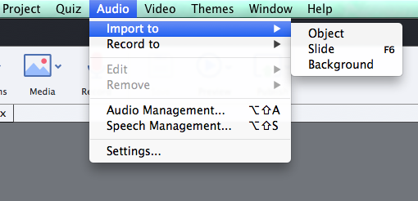
ADDING TO CAPTIVATE
CAPTIVATING SOUNDTRACKS

Slide 12
VIEWING SOUND BITE IN THE TIMELINE
CAPTIVATING SOUNDTRACKS

Slide 13
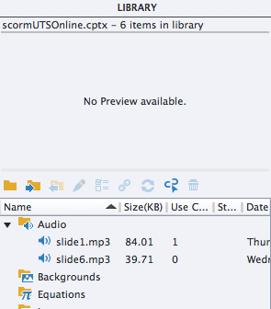
THE CAPTIVATE LIBRARY
Find tracks in the library
CAPTIVATING SOUNDTRACKS

Slide 14
Any Questions?
CAPTIVATING SOUNDTRACKS

